Slide 1
Carbon dioxide in Seawater
CO2(g) ⇔ CO2(aq

Slide 2
As we release more CO2 into the atmosphere due to our activities, and global temperatures increase, would you expect there to be more or less carbon dioxide dissolving in the ocean?

Slide 3
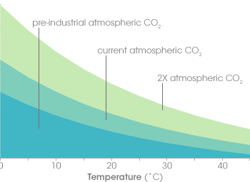
The concentration of carbon dioxide (CO2) in ocean water (y axis) depends on the amount of CO2 in the atmosphere (shaded curves) and the temperature of the water (x axis).

Slide 4
As water temperature increases, its ability dissolve CO2 decreases.
Global warming is expected to reduce the ocean’s ability to absorb CO2, leaving more in the atmosphere…which will lead to even higher temperatures.

Slide 5
As temperatures rise, carbon dioxide leaks out of the ocean like a glass of root beer going flat on a warm day.
Carbonate gets used up and has to be re-stocked by upwelling of deeper waters, which are rich in carbonate dissolved from limestone and other rocks.

Slide 6
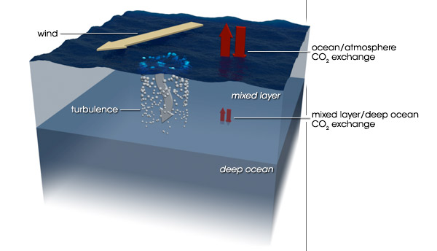
In the centre of the ocean, wind-driven currents bring cool waters and fresh carbonate to the surface.
The new water takes up yet more carbon to match the atmosphere, while the old water carries the carbon it has captured into the ocean.

Slide 7
The warmer the surface water becomes, the harder it is for winds to mix the surface layers with the deeper layers.
The ocean settles into layers, or stratifies.
Without an infusion of fresh carbonate-rich water from below, the surface water saturates with carbon dioxide.
The stagnant water also supports fewer phytoplankton, and carbon dioxide uptake from photosynthesis slows. In short, stratification cuts down the amount of carbon the ocean can take up.

Slide 8
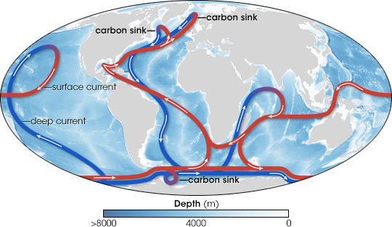
Ocean currents
The global oceans are connected by deep currents (blue lines) and surface currents (red).

Slide 9
Carbon from the atmosphere enters the ocean depths in areas of deep water formation in the North Atlantic and offshore of the Antarctic Peninsula.
Where deep currents rise towards the surface, they can release “fossil” carbon dioxide stored centuries ago.

Slide 10
The ocean–atmosphere system
Take a deep breath. It’s possible that among the molecules of the CO2 you inhaled some were emitted from burning the first tonne of coal in the first steam engine built by James Watt—the engines that powered the Industrial Revolution. Since that first engine began operating, more than 300 gigatonnes of carbon, GtC (≈ 1,100 Gt CO2), from the fossil fuel reservoir in this figure have been added to the atmosphere by human activities. About two-thirds is still there, included in the 800 GtC in the figure. Much of the rest is in the ocean.

Slide 12
This figure represents how carbon is stored and interchanged among various reservoirs on Earth. The numbers in the labeled boxes are gigatonnes (1015 g) of carbon, GtC, in that reservoir. The numbers associated with the interchange arrows are approximate annual fluxes, GtC•yr–1, between reservoirs. The numeric values are for 2012. The timescales are an indication of how long it takes a change within the denoted reservoirs to come to equilibrium. Sedimentary rocks, formed from these sediments deep in the Earth over even longer times than here, constitute the largest carbon reservoir of all, about 100,000,000 GtC.

Slide 13
How have scientists found this out?
The oceanography community measure dissolved carbon and the ocean’s pH.
They probe its temperature, alkalinity, salinity, and record the presence of tracers like chlorofluorocarbons or helium to find out when the water was last exposed to the atmosphere.
By the end of a typical cruise, they will have collected 50,000 or more measurements. And then they go out the next year to repeat it all again, and they have done this for more than three decades.

Slide 14
