Slide 1
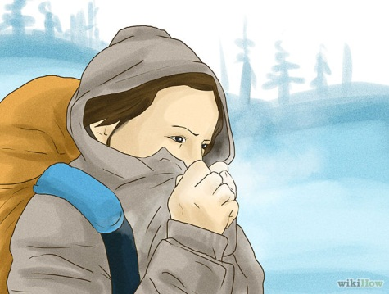
Homeostasis
Year 13 Biology
NCEA Level 3

Slide 2
Homeostasis - definition
Maintenance of a consistent internal environment (of all or part of the body)
Homeo = same
Stasis = state

Slide 3
Examples of Homeostasis
Blood volume
Dehydrated
Produce less urine
Feel thirsty to encourage you to drink
Over hydrated
Produce more urine
Do not feel thirsty
Cold weather
Lose heat  appetite increases

Slide 4
Components of a Homeostatic System
Communication
system
Receptor
Effector
Stimulus
Response
The body must be able to detect a change
Stimulus is detected by a receptor
One or more effector(s) bring about a response
Receptors linked to effectors by a communication system

Slide 5
Communication Systems
Feature: | Nervous Systems | Endocrine System (hormones)
Route Travelled | Specific pathways | Via blood
Time to reach target | Milliseconds | Seconds
Cells reached | Only those at the end of the nerve | Entire body (not all cells respond)
Strength of signal indicated by | Frequency of impulses | Concentration of hormone
Duration of signal | Millisecond for each impulse | Minutes to hours or days
Nervous system used for rapid responses
Skeletal muscles
Hormones are used for prolonged responses
Lack of food or water

Slide 6
Homeostasis involves Feedback
Detection of change away ‘normal’
e.g. CO₂ levels during exercise
Increased rate of CO₂ excretion
Increased breathing rate
Normal blood CO₂ (set point)
Increased muscular activity
CO₂ levels in blood rise

Slide 7
Feedback loops
The higher blood CO₂ levels rises ABOVE normal, the greater the stimulation of breathing muscles
more CO₂ is excreted
This is an example of a NEGATIVE FEEDBACK
CO₂ levels fluctuate above and below normal and the rate of breathing adjusts to suit

Slide 8
Differences between Positive and Negative Feedback
Negative feedback promotes stability
Positive feedback promotes the opposite

Slide 9
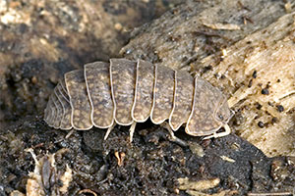
Homeostasis and Behaviour
Behaviour can be used to limit the degree of change in an internal environment
Slaters are nocturnal
Relative humidity is higher so water loss is lower
Slaters tend to move more rapidly in dry air than in humid air (kinesis)
In damp air slaters move slower making them more likely to stay longer in the damp air

