Slide 1
Hormonal Control
Year 13 Biology
Homeostasis

Slide 2
Hormone Signalling
Forms part of the endocrine system
Uses chemicals in the blood to carry signals
Hormones are secreted by glands (that do not contain a duct)
Small proteins – insulin
Steroids – testosterone, oestrogen
Amino Acids – thyroxine, adrenaline

Slide 3
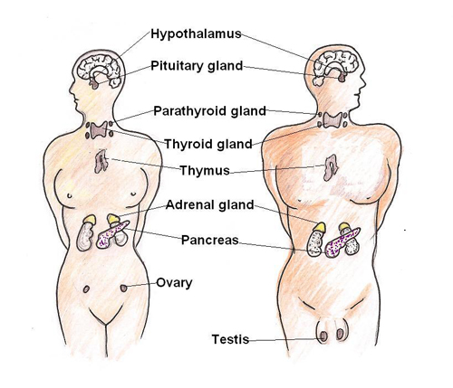
Main Glands

Slide 4
Receptors
For hormones to work
the target cell must have a receptor specific for the hormone on the outside of the cell

Slide 5
Nervous System vs. Hormones
Nervous
Hormones
Quick acting
Short lived response
Specific part of the body
Slow acting
Long duration responses
Widespread
More than one hormone can influence individual cells
Can work together to regulate the size of the response
Need to break down the hormone on completion

