Slide 1
Nervous Communication
Year 13 Biology

Slide 2
Functions of the Nervous System
Communication
Information is transmitted to one part of the body to another.
Integration
Working together.
Storage of information (memory)

Slide 3
Nervous System in Mammals
Contains three parts
Central Nervous system that includes the brain and spinal cord
Peripheral Nervous system and includes the cranial nerves connecting to the brain and the spinal nerves connecting to the spinal cord. Involves most of the body’s nerves.
Autonomic Nervous system which is under the subconscious control of the brain and regulates action of glands.

Slide 4
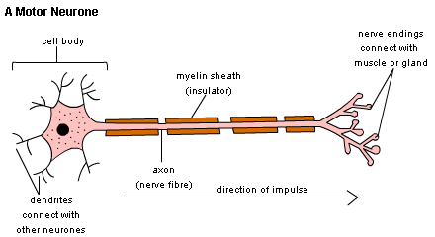
Neurons
Axon carries the impulses
Dendrites cover a large area

Slide 5
Different type of Neurons
Motor neurons
Carry information from the CNS to effectors
Receptor neurons
Carry information from receptor to the CNS
They are sensory or afferent neurons
Interneurons
Link sensory neurons with motor neurons

Slide 6
Protection for the CNS
Protected by three layers
Bones like the skull and backbone
Cerebrospinal fluid
Meninges
Three membranes that protect the CNS

Slide 7
Speeding up Transmission of Nerve Impulses
Axons of animals coated with a myelin sheath
Sheath forms a layer of insulation
Nodes of Ranvier are gaps in the myelin sheath
Sheath made up of Schwann Cells

Slide 8
Properties of the Impulse
A resting nerve cell has an electrical potential between the inside and outside of the cell
Outside is positive relative to the negative inside
‘resting potential’
Nerve impulse or action potential is a short reversal of this difference and includes the recovery
The nerve impulse does not diminish as it moves along the axon

Slide 9
Properties of the Impulse
It is an all or nothing
The impulse must be larger than a threshold
Refractory Period is the length of time the neuron takes to recover after an impulse
Nerve impulses use ions like Na⁺ and K⁺ rather than electrons

Slide 10
Synapses
Nerves communicate with each other via synapses
Synaptic cleft is a gap between the neurones
A chemical called a neurotransmitter is produced at the end of one neuron. This chemical can travel across the synaptic cleft

Slide 11
The Autonomic Nervous System
Some systems are not under conscious control
Heart and glands
They are controlled by the autonomic nervous system
This system includes
Sympathetic - responds to stress (exercise, cold)
Leave the CNS via spinal nerves
Parasympathetic – controls processes like digestion, recuperation
Leave via cranial nerves

Slide 12
Effector
Are the responders to changes in your body
Glands
Muscles
There are two types of muscles
Striated muscles
Smooth muscles

Slide 13
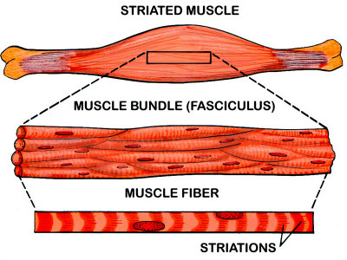
Striated Muscles (skeletal muscles)
Contracts rapidly
Tires easily
Contains many fibres that coordinate together
Required nervous input

Slide 14
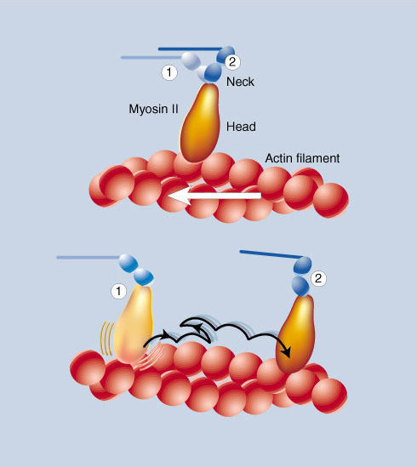
The machines in Your Muscles

Slide 15
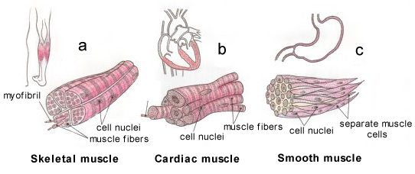
Smooth Muscle
This type of muscle does not need controlling
Found in the walls of internal cavities
Gut, bladder, blood vessels

