Slide 1
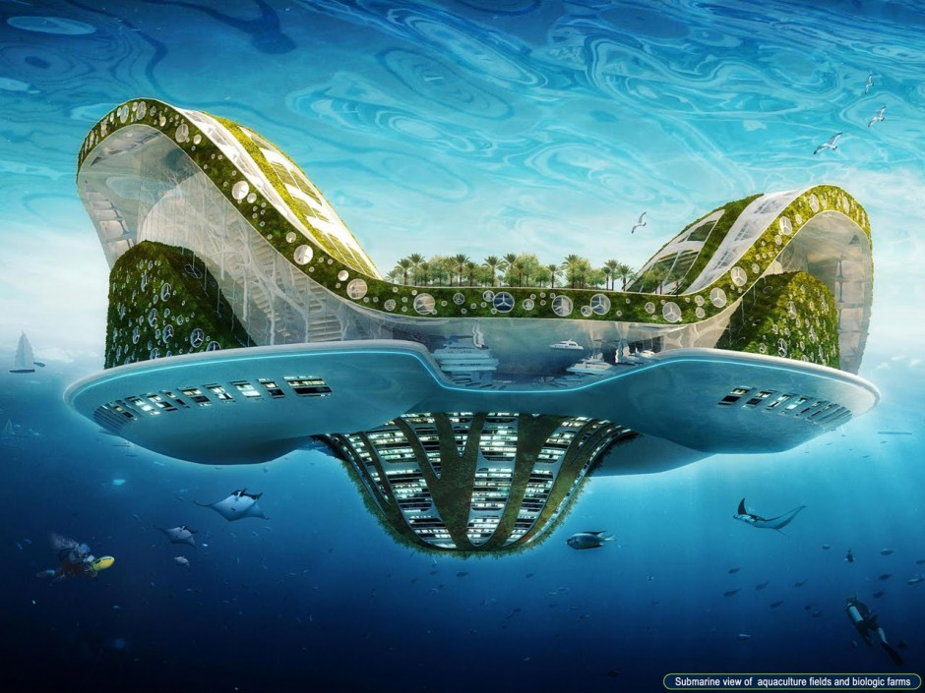
The Future

Slide 3
The short-lived bright side
Initially, the ocean absorbing excess CO2 from the air will provide a benefit.
CO2 is a greenhouse gas which traps infrared radiation in the atmosphere.
The ocean will absorb a significant amount of CO2, reducing the concentration of CO2 in the atmosphere.
This will slightly dull the effects of global warming.
However, as the concentration of CO2 in the seawater increases, there will be a point where no more can be absorbed, and any more CO2 which is produced will remain in the atmosphere unless used as a reactant for photosynthesis.

Slide 4
Solutions
To help slow down the rate of ocean acidification, there are a couple of things we could do.
Reduce the amount of CO2 gas being released into the atmosphere.
The burning of fossil fuels is a major contributor to ocean acidification.
Currently, more CO2 is being produced faster than it can be absorbed through natural processes, causing an imbalance.
We can reduce CO2 emissions in many ways: using less energy, being more efficient when it comes to transport, recycling products to reduce demand, finding ways to replace fossil fuel usage.

Slide 5
.
Photosynthesis. We could use photosynthesis to ‘mop up’ the excess CO2.
More algae, seaweed, or land plants would be grown to increase the rate at which CO2 is being converted to glucose as part of photosynthesis.
To create one molecule of glucose, six CO2 molecules are required. This would allow for less CO2 gas to be present in the atmosphere and ocean, slowing the conversion of CO2 to carbonic acid.

Slide 6
It takes time
While these changes may take time to process, and turn into action, there will be a buffering effect which will delay the reaction of ocean acidification to the reduced carbon emissions.

Slide 7
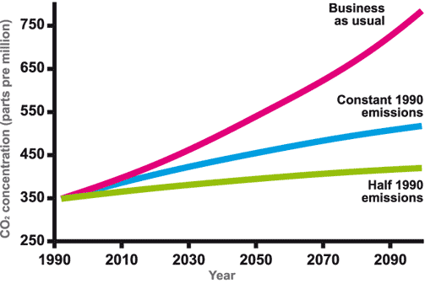
Projected CO2 emissions

Slide 8
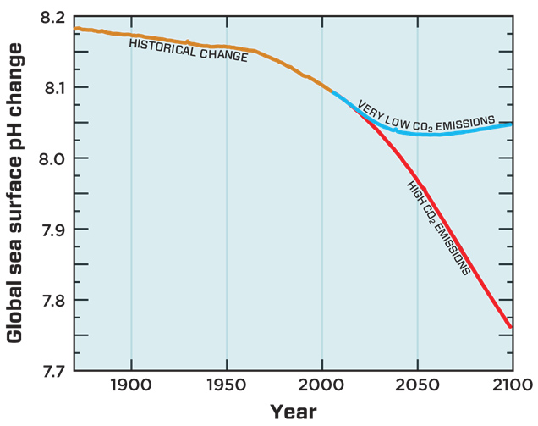
Projected ocean pH

Slide 9
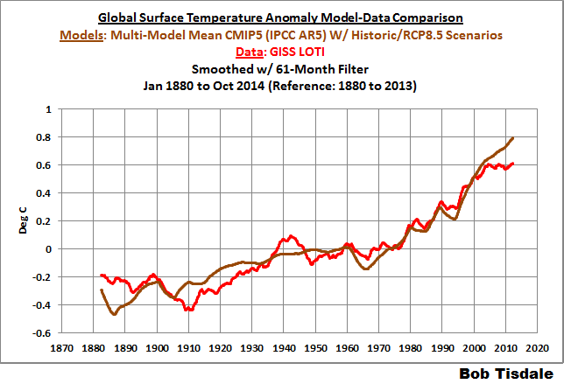
Projected ocean temperature

Slide 10
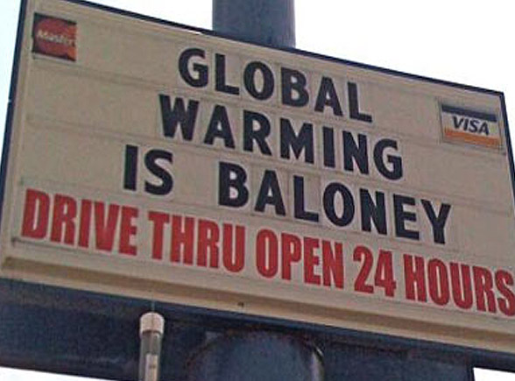
The climate change Deniers

Slide 12
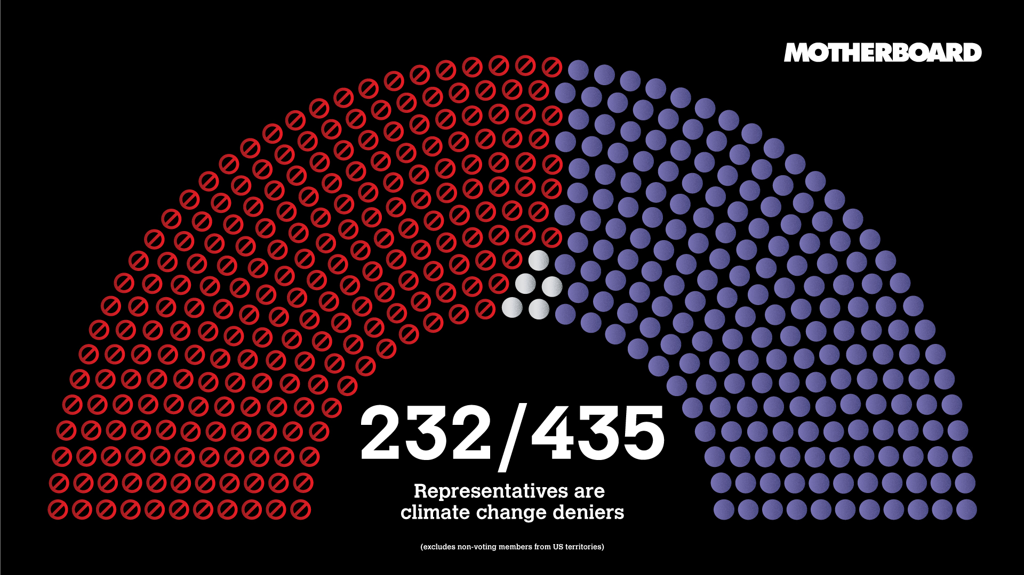

Slide 14
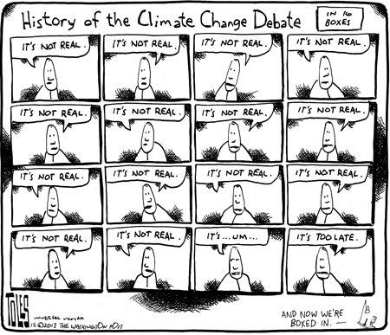

Slide 15
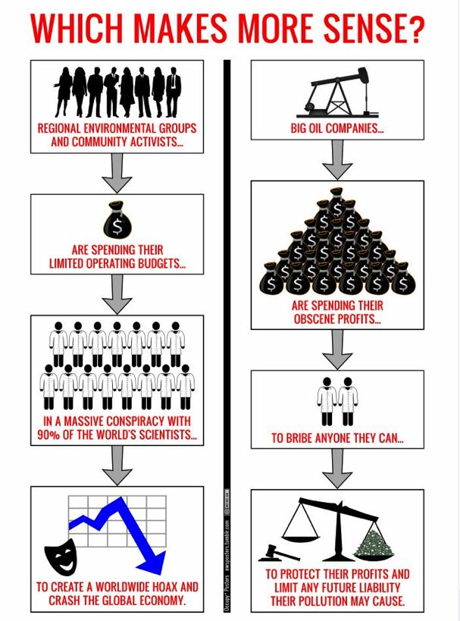

Slide 16
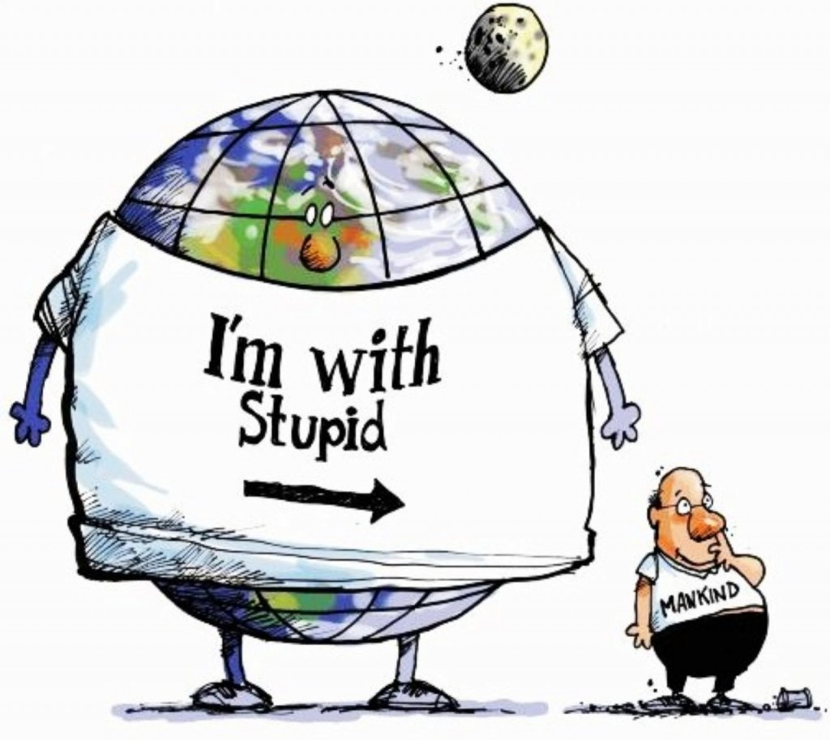
Solutions to ocean acidification

