Slide 1
The relevance of equations when looking at ocean acidification

Slide 2
The CO2 problem
Over time, humans have increased their demand for products.
This has caused an increase in the amount of CO2 gas being emitted in the air.
One million tonnes of CO2 is released every hour, and 30% of these omissions are absorbed by the ocean.

Slide 3
How does the ocean absorb CO2?
As CO2 is released into the air, it slowly dissolves into sea water.
CO2 is the solute to water (sovent).
When CO2 dissolves it gets surrounded by particles of H2O which carry it, and mix the molecules into the water.
CO2(g) CO2 (aq)
This equation is in equilibrium – it does not go into completion and is at a point where the forward reaction is balanced by the reverse reaction.

Slide 4
Le Chatelier’s principle
When atmospheric CO2 rises, the direction of the equilibrium shifts, causing more CO2 to be absorbed into the ocean.
This is known at Le Chatelier’s principle.
This principle can be used to predict the effect of change in an equilibrium.
It states that when a system in equilibrium is subjected to change (temperature, pressure etc) the system will adjust to counteract the change.
Le Chatlier's principle video

Slide 7
ere

Slide 8
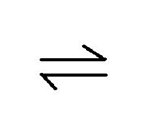
An example
When CO2 dissolves in seawater, only a certain amount will dissolve.
This amount can be increased by increasing the pressure, which shifts the direction of the equilibrium to allow more gaseous CO2 to be converted to aqueous CO2.
aA + bB cCc + Dd
Kc = (C)c(D)d (A)a (B)b
This increase in CO2 concentrations in water causes many reactions which affect ocean chemistry.
These effects can have consequences on marine life, their food chains and human economics.

Slide 9
How does the amount of CO2 in the air alter the oceans’ pH?
Carbonic acid – H2CO3 is an acid because it can be spilt up into its constituents.
It is made-up of a carbonate molecule and two hydrogen atoms.
This breaks down and causes a release of H+ ions and bicarbonate ions (HCO3-) present in the water.
The increase in H+ ion concentration causes the ocean to become more acidic.

Slide 10
pH
pH is a logarithmic scale.
The range between a strongly acidic solution (pH 0) and a strongly basic solution (pH 14) is extremely large and can differ by over 100 million ions (H+ for acidity and OH- for alkaline).
Each unit of change in the pH scale corresponds to a 10 fold change in the concentration of ions.
This is why a change of pH of 8.2 in seawater to a pH of 8.1 is quite a dramatic change in the concentration of H+ ions.
As a consequence, the more H+ ions present in seawater, the more carbonate molecules which will be lost to carbonic acid.

Slide 11
The pH equation
ph = -log [H+]
This equation can be used to work out what the pH is of a particular substance.
The pH equation
Solving pH equations
Practice pH problem From 29:31mins

Slide 12
A report by the United Nations Convention on Biological Diversity last year noted that the ocean’s pH, a measure of acidity, had decreased by 26 per cent since the start of the industrial revolution, mirroring the proportion of manmade CO2 emissions that the oceans absorb from the air.

Slide 13
Globally the oceans’ average pH is currently 8.1, which is 0.1 lower than it was 250 years ago. This may not sound significant, but the pH scale is logarithmic, so a decrease of one pH unit represents a 10-fold increase in the acidity. What’s worse, this decline in pH is projected to continue in line with the increase in atmospheric CO2, leading to the most rapid decrease in ocean pH in the past 50 million years.

Slide 14
Ocean acidification has happened before. CO2 from Siberian volcanoes caused the world’s oceans to acidify 251 million years ago, generating the greatest ever extinction of life on this planet.
Do reading on ‘The great dying’.
The great dying

Slide 15
CO2 in the atmosphere has increased fro 278ppm in pre-industrialised times to 399 ppm today.
During this time, the amount of CO2 dissolved in the ocean has risen by more than 30%, decreasing the pH of the ocean by 0.11 units.
As with CO2 and global warming there is some lag between cause and effect, meaning that even if all carbon emissions stopped today, we are committed to a further drop of up to 0.1 units.

Slide 16
So what happens to CO2 as it dissolves in seawater?
There are three stages to what happens to carbon dioxide as it dissolves in seawater:
CO2 + H20 H2CO3 This show that when carbon dioxide dissolves in seawater, carbonic acid is formed.
H2CO3 H+ + HCO3- The carbonic acid is dissociated into its hygrogen ion components and bicabonate ion components. This adds hydrogen ions (or more correctly hydronium ions) into the seawater, and is essentially what makes the seawater acidic.

Slide 17
2. H+ + CO3 -2 HCO3- The additional H+ ions released by carbonic acid bind to carbonate ions forming additional bicarbonate. This reduces the concentration of carbonate, making it harder for marine creatures to take up carbonate to form the Calcium carbonate needed to build their exoskeletons.
3. Ca2+ + CO32- CaCO3

Slide 18
The confusion of ocean acidification equations
The equations showing CO2 reacting with water look like they generate more, not less carbonate. How does ocean acidification decrease the amount of carbonate ions in seawater?
This is a common point of confusion, because step-by-step equilibrium equations describing the carbonate system in seawater do not capture the dynamic chemical environment of seawater.
There are several reactions that can occur between carbon dioxide (CO2), water (H2O), carbonic acid (H2CO3), bicarbonate ion
(HCO3-), and carbonate ion (CO32-). One of the possible reactions does create carbonate ions and lowers pH:
CO2 + H2O ⇔ H2CO3 ⇔ H+ + HCO3- ⇔ 2H+ + CO32-

Slide 19
However, at the current ocean pH level, another reaction also occurs that consumes carbonate ions and does not change pH:
CO2 + H2O + CO32- ⇔ 2HCO3-
The second equation describes the reaction that occurs most often in the modern oceans, but the first reaction also occurs, so the resulting overall change is a decrease in carbonate and a decrease in pH.
Ocean acidification equations

Slide 20
The decrease in carbonate
This is a serious issue for marine organisms that need calcium carbonate to build their exoskeletons.
The main two forms used by marine creatures are calcite and argonite.
Decreasing the amount of carbonate ions in the water makes conditions more difficult for both calcite users and argonite users.

Slide 21
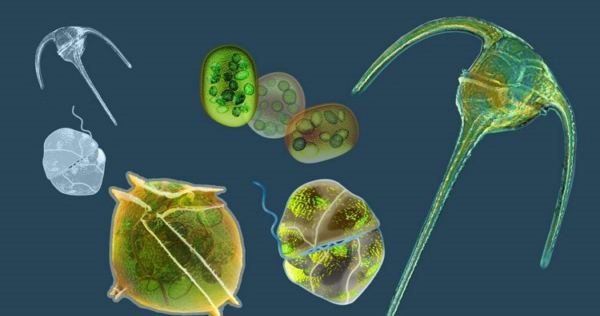
Calcite users
Phytoplankton

Slide 22
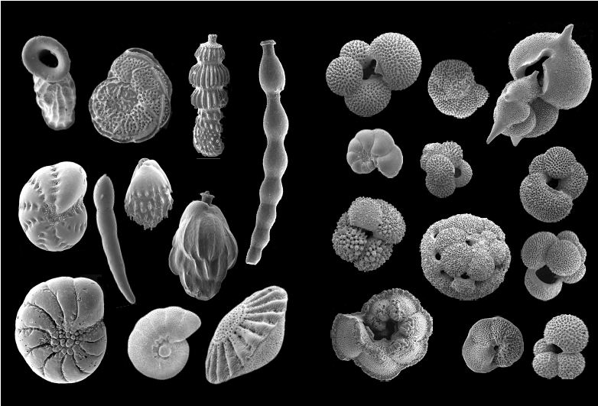
Foraminifera (diatoms)

Slide 23
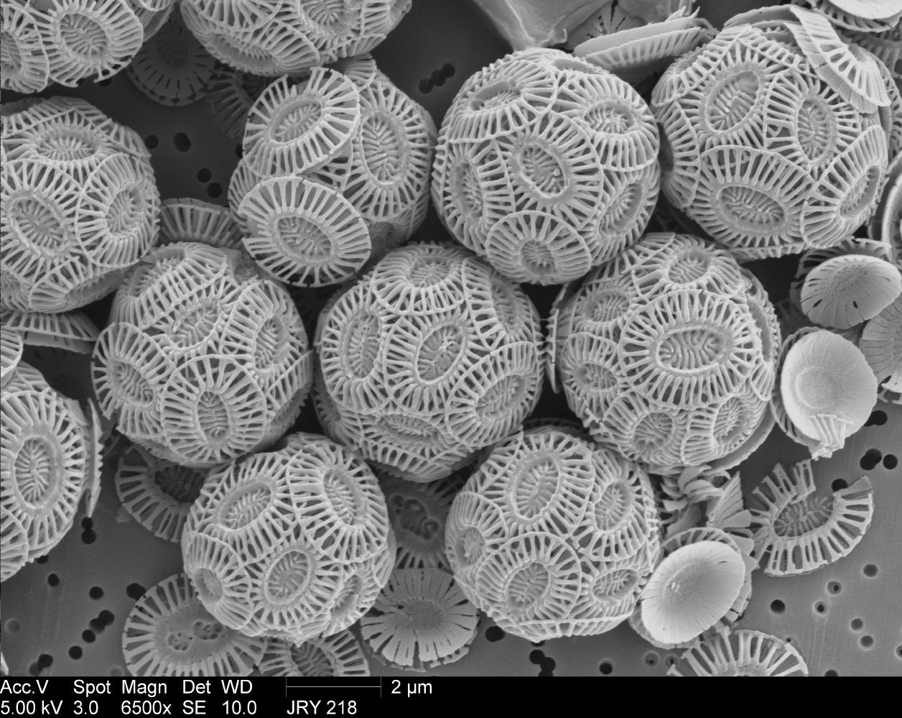
Coccolithophores

Slide 24
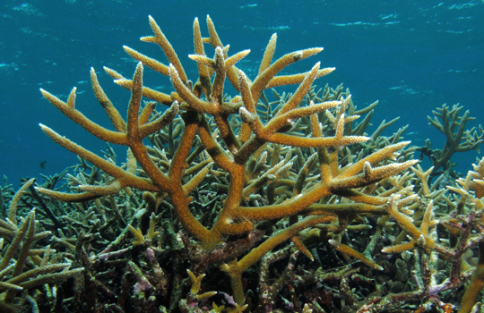
Argonite users
Coral

Slide 25
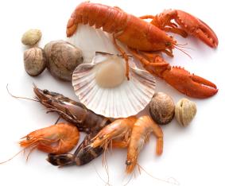
Shellfish

Slide 26
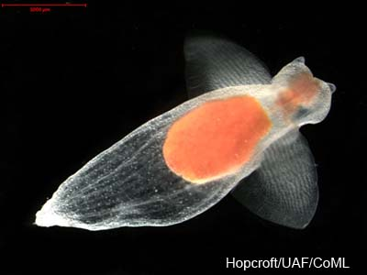
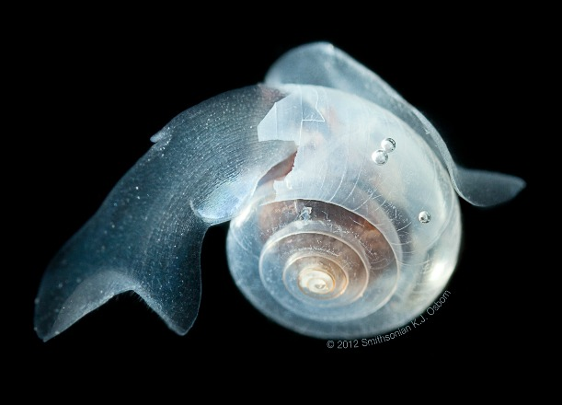
Pteropods

Slide 27
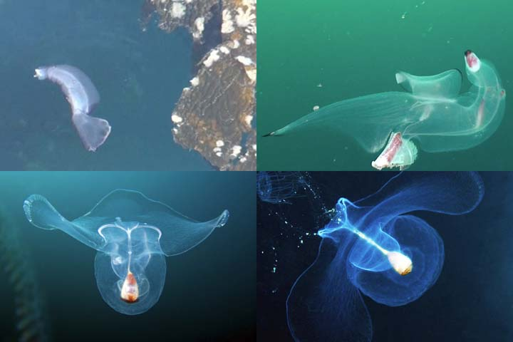
Heteropods (sea elephants)

Slide 28
Calcite and Argonite How are they different?
Calcite and argonite are polymorphs – they have the same chemical formula of calcium carbonate, but different reactive properties.
Calcite has a rhombohedral shape, whereas argonite has an othorhomic shape.

Slide 29
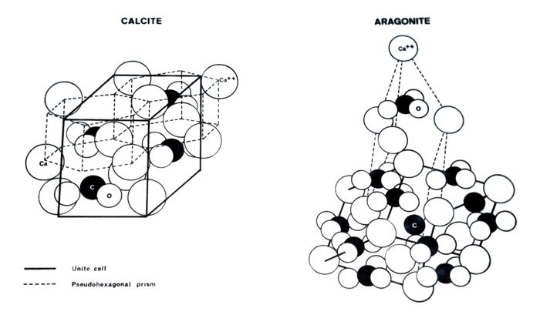

Slide 30
Argonite is metastable (has a more ‘excited’ nucleus/atom) and is 1.5x more soluble than calcite.
This causes argonite to be more readily dissolvable and affects organisms which prefer argonite to build their structures eg coral.

Slide 31
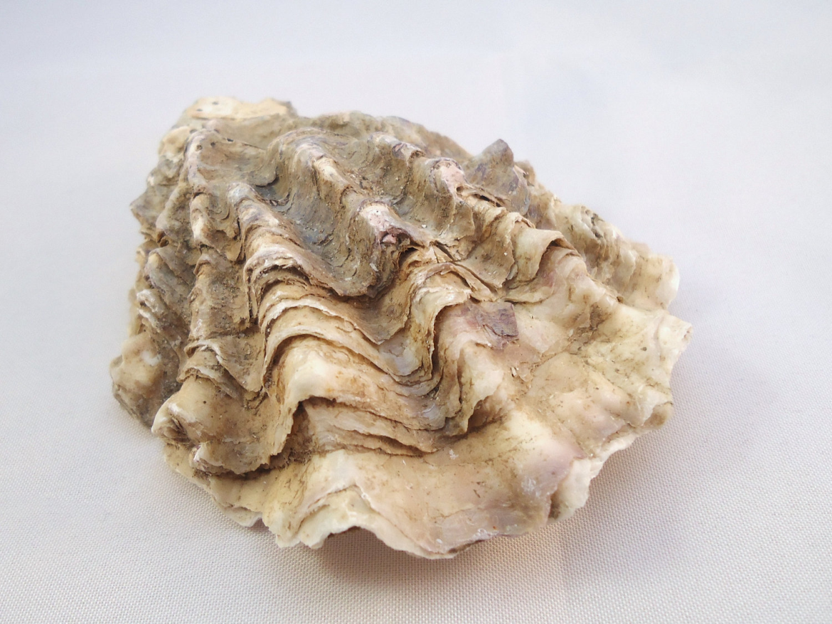
Mollusc shells are made-up of 2% protein and calcium carbonate.
The proteins guide the way for calcium carbonate ions to bond and form the patterns we see in shells, such as the rough surface of an oyster shell.

Slide 32
In consequence to the decreasing ocean pH, there will be less calcium carbonate for mollusc species, such as mussels, sea snails and oysters, to use for vital shell-building, making mollusc species more vulnerable.

Slide 33
Calcium carbonate in shells also dissolves and releases carbonate and calcium ions into the water.
CaCO3 Ca2+ + CO32-
This increase in Hydrogen ions shifts this equilibrium to the right, causing more calcium carbonate to be dissolved.
This also comes with more energy expense to molluscs as energy is required for the maintenance of their shells.
Shells will dissolve in carbonate and calcium ions at a slightly faster rate (new ocean pH of 8.1) than it would have in a more basic ocean pH of 8.2.

