Slide 1
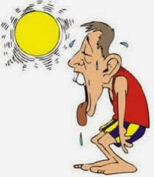
Thermoregulation

Slide 2
Terminology
Often described as "warm-blooded" humans are in fact homeothermic. We are able to regulate the rate at which we generate and dissipate (lose) heat.
This is in contrast to "cold-blooded" or poikilothermic organisms whose internal environment fluctuates as their external conditions change.
Poikilothermic = cold blooded. Require external heat sources to regulate body temperature. Ectotherms
Homeotherms = warm blooded. Are able to maintain a consistent internal temperature. Endotherms

Slide 3
Questions to ponder
1) How do we generate heat?
2) Why is it necessary to lose heat?
3) How can environmental conditions affect our ability to thermoregulate?
Temperature homeostasis

Slide 4
It is important to remember that our bodies have evolved in relation to the normal fluctuation of environmental conditions and temperatures experienced by our ancestors. Brief changes to internal metabolic rate and/or external environmental conditions rely on a constant negative feedback loop to make minor adjustments to heat production and heat dissipation (loss).

Slide 5
Endotherm body temperature
On average, the normal body temperature for humans is around 37⁰C
Healthy humans: AM 35.8 ⁰C PM 37.3 ⁰C
Varies with level of activity. Can rise to 40⁰C
Menstruation increases body temperature
0.3⁰C
Varies from one part of the body to another (esp. the outer ‘shell’ and the limbs).

Slide 7
From the graphic below, one can see the narrow tolerance range for internal temperature fluctuations and the responses that are initiated in an effort to restore homeostasis. Under extreme conditions, the limitations of our system may be tested.

Slide 8
Why do we die if it’s cold?
Enzymes are temperature sensitive.
Proteins only function in a fluid lipid bilayer – too cold and it freezes.
Hydrogen bonds holding the two strands of DNA together break, becoming single-stranded.
Thermoregulation

Slide 9
Balance
Incomings (heat gain) and outgoings (heat lost) must be in balance.
Fall in body temperature leads to a corrective decrease in heat loss and an increase in heat production (prolonged cold).
Control of body temperature involves a thermostat located in the hypothalamus.
Changes are detected by thermoreceptors.
Effectors receive information from the hypothalamus.

Slide 10
Control
Heat loss is controlled by the ANS – involves rapid responses by effectors in the skin.
Heat production can be increased short-term and is controlled by the NS.
Long-term changes in heat production are controlled by the endocrine system.
Are widespread and prolonged.

Slide 11
Heat loss and skin
Heat can be lost in three ways:
Radiation
Conduction
Evaporation
Heat transfer

Slide 12
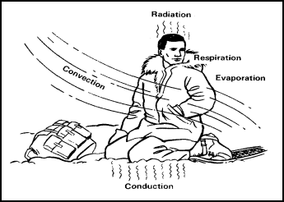

Slide 13
Radiation
A warm body emits heat in the form of infrared radiation.
At 20⁰C about half heat lost is by radiation.
Heat can be gained by radiation from hot objects eg the Sun
Radiation

Slide 14
Conduction
If air is cooler than your body, your heat is conducted from the body through the air.
The rate of heat loss is influenced by:
Thermal conductivity of material next to skin (water loses heat 25x faster, fat conducts heat about ⅓ the rate of lean tissue).
The temperature gradient (how quickly temperature changes with distance) eg animal fur thickness.
Conduction

Slide 15
Evaporation
Except in saturated air, we lose water by evaporation.
The change form liquid to gas produces latent heat producing a cooling effect.
Is the only way heat can be transferred from a lower to a higher temperature (to keep cooler than surroundings, water has to be lost).
Cool temperatures – evaporation in uncontrolled (insensible) . Water evaporates at about 50cm³/hour (0.05 litre) from breathing/skin.
Higher temperature – produce sweat, cools skin.
Very high temperatures – 1.5 litres sweat/hour.
How does sweat work?

Slide 16
Convection
Convection is the transfer of heat by the movement of a fluid (liquid or gas) between areas of different temperature.
Happens in two ways:
Free convection – liquid/gas moves from warmer to cooler area.
Forced convection – liquid/gas moves from higher to lower pressure eg wind, breathing, blood flow.

Slide 17
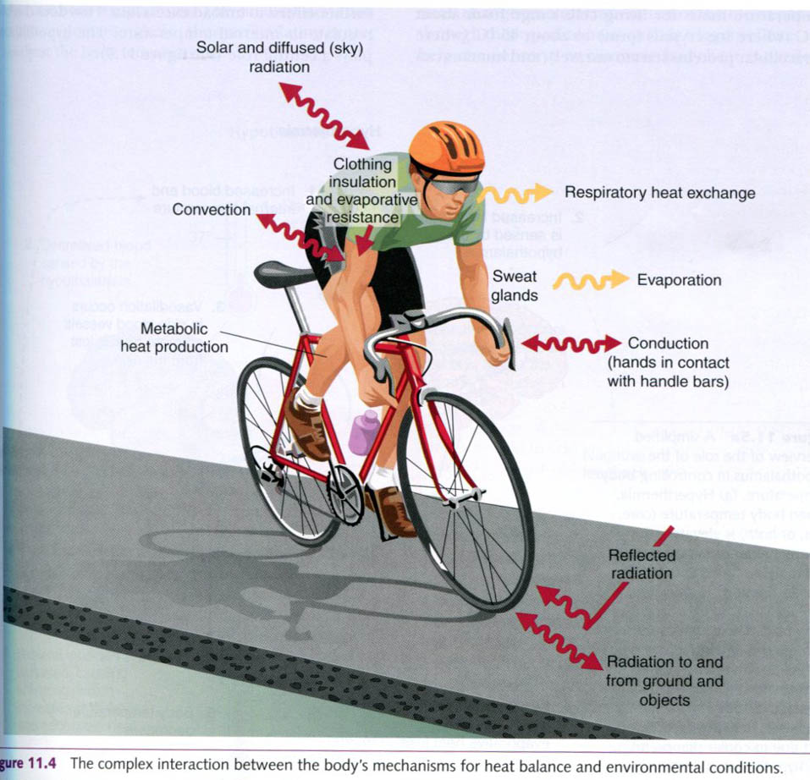

Slide 18
The Skin
The largest organ.
Plays a vital role in temperature regulation:
Receptors detect changes.
Contains effectors.
Two main parts:
The outer epidermis
The inner dermis.

Slide 19
The outer epidermis
The outer layer of the skin
Main purpose is protection
Tough
Produces keratin
Innermost cells constantly dividing and form the malpighian layer.
Outermost cells made up of a dead cornified layer.

Slide 22
The inner dermis
Much thicker
Network of collagen and elastin (fibrous proteins)
Contains:
Hair follicles – contain effector muscles to change angle of hair/adjust thickness
Sweat glands – supplied by sympathetic nerve fibre
Blood vessels – bring heat to body surface
Afferent nerve endings – sensitive to changes in temperature
Adipose – beneath the dermis. Fat storage tissue (energy reserves plus thermal insulator)

Slide 23
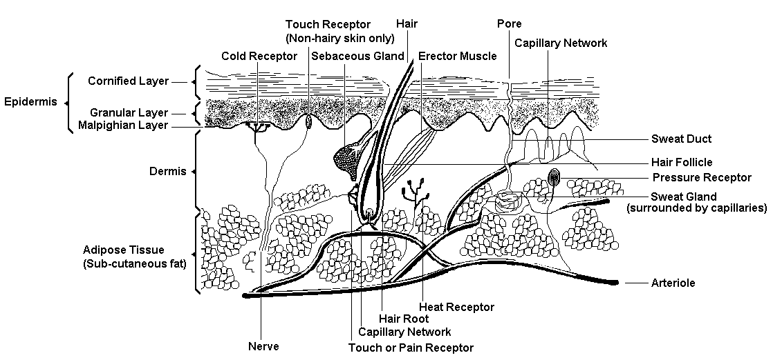

Slide 24
Heat production (thermogenesis)
Chemical energy taken in is changed to heat energy produced in metabolism.
In endotherms, this is the main source of heat.
Different organs produce heat at different rates. (see table pg 183 textbook)
The minimum level of activity required to sustain life-essential functions is the basal metabolic rate.

Slide 25
Responses to cold
Responses to rapid change mediated by the nervous system.
Slower responses involve metabolic changes and are under endocrine control.

Slide 26
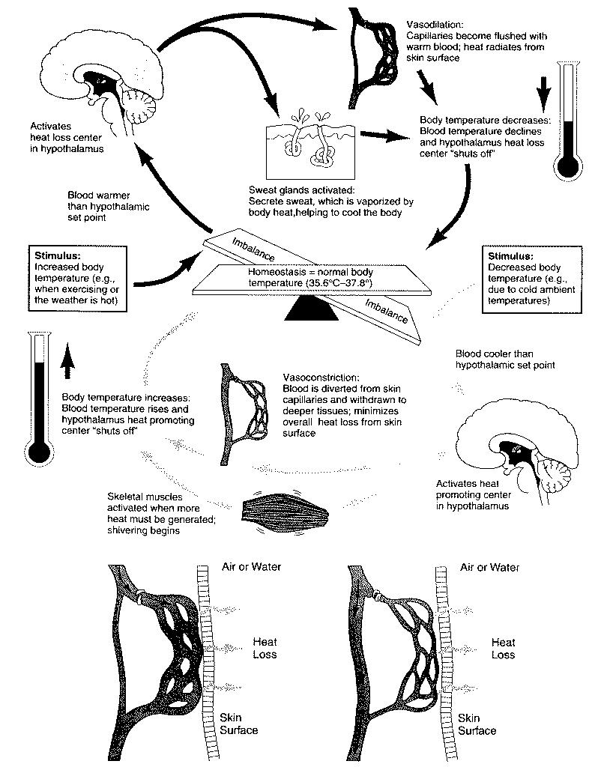

Slide 27
Neural responses
Response to cooling = increased heat loss and increased heat production.
Heat loss reduced by decreased blood flow to the skin and rate it’s conducted through the air.
Thermoreceptors/hypothalamus detect fall in core body temperature – corrective signals are sent out via sympathetic nerves to effectors in the skin.

Slide 28
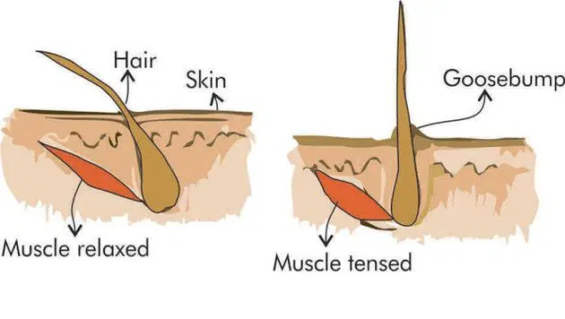
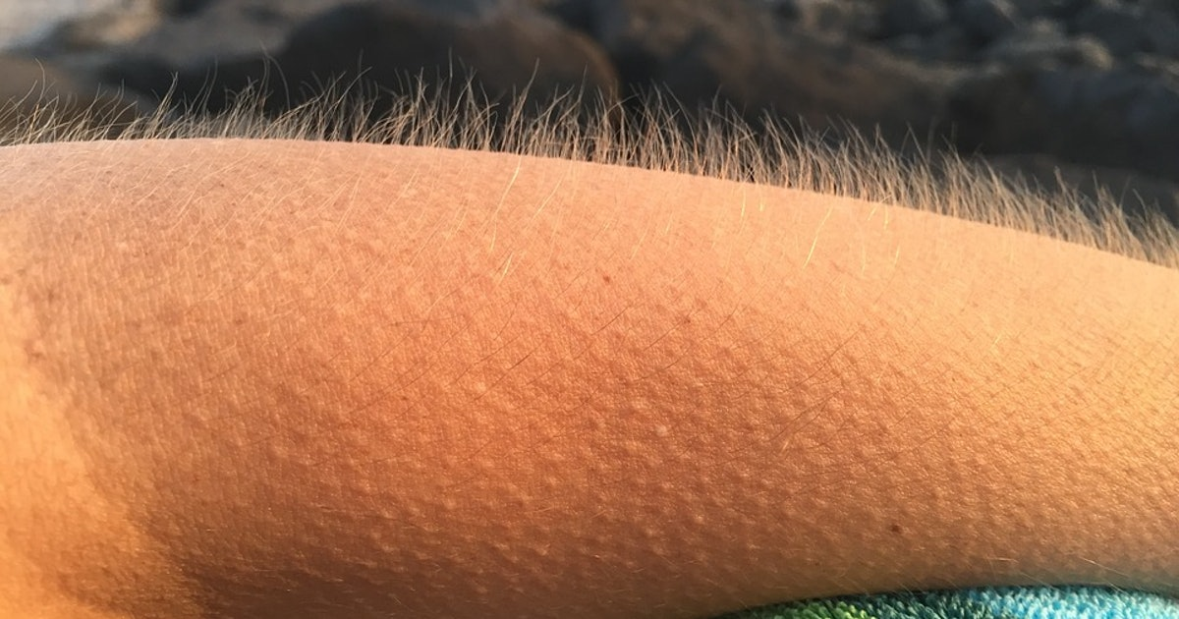
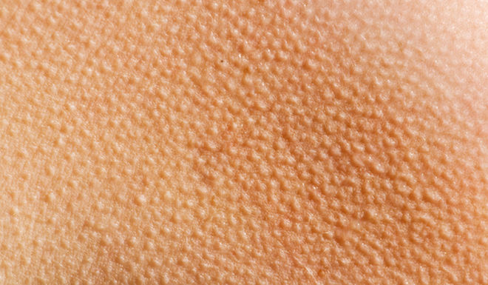

Slide 29
Neural responses
Sudden cooling - increased frequency of impulses to smooth muscle in arterioles causing vasoconstriction.
Erector muscles contract increasing thickness of still air next to the skin.
Role of the skin in temperature regulation
Second response – shivering releases heat, like any muscle contraction.
Increased metabolic rate by noradrenaline being released by sympathetic nerve fibres.

Slide 30
Vasoconstriction and Vasodilation
Vasodilation is the widening of blood vessels.
It results from relaxation of smooth muscle cells within the vessel walls, in particular in the large veins, large arteries, and smaller arterioles. The process is the opposite of vasoconstriction, which is the narrowing of blood vessels.

Slide 32
Hormonal receptors
Long-term heat loss.
Most important hormones – adrenaline and thyroxine.
Adrenaline – short-term changes in temperature.
Thyroxine – long-term changes. Effects are delayed and prolonged.
Hypothalamus stimulates release of TRH (thyrotropin releasing hormone). This stimulates anterior pituitary to increase output of thyrotropin or TSH (thyroid stimulating hormone).
Thyroxine secretion rises increasing basal metabolic rate.

Slide 33
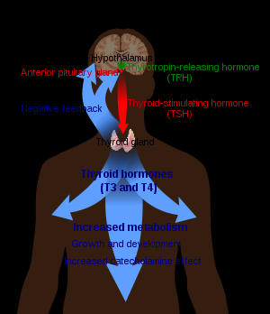

Slide 34
Costs/benefits from endothermy
Can be active in a wide range of environments.
Uses lots of energy.
Loss of water (diet rich in protein due to need of energy, sweating).

